Slide 1
Trends in Amphibian Occupancy in the United States
Authors; Michael J. Adams, David A. Miller, Erin Muths, Paul Stephen Corn, Evan H. Campbell Grant, Larissa L. Bailey, Gary M. Fellers, Robert N. Fisher, Walter J. sadinski, Hard Waddle, Susan C. Walls.
Sources include; Adams MJ, Miller DAW, Muths E, Corn PS, Grant EHC, et al (2013)/ journal.pone.0064347
Editor: Han Y. H. Chen, Lakehead University
published May22, 2013

Slide 2
Purpose of the study:
To analyze the rate of change in the probability that amphibians occupy ponds and other comparable habitat features across the United states

Slide 3
Outline:
Introduction
Methods
Results
Discussion
Conclusion

Slide 4
Introduction
The first amphibian decline was detected in the late 1980s
In the report released in 2004 by global assessment of amphibian, 32.5% of the world species were declining while in United States’ 31.7% was on the decline also.
The extinction rate of the amphibians was 211 time more than the background rate according to Geological Survey’s Amphibian Research and Monitoring Initiative.
Getting documented population rate change indeed required intensive studies hence using the AMRI data helped in conducting a quality research since they use repeated surveys to statistically account for the probability of knowing the species that is present.
Previously conducted research relied on individual data count which made it less reliable.
The research presented was one of the kind as it presented broad assessment of amphibians while still conforming to research recommendation.

Slide 5
Methods used:
The Authors used estimates of occupancy that were available at armi.usgs.gov.
The null hypothesis was evaluated using the likelihood-ratio tests.
Delta method was used to get the annual rate of change.
For each study in AMRI, estimates generated used some form of repeated observation to detect amphibians.
The survey done was visual and it was used for logical reasons such as increasing the probability of species detection
To estimate the location of the species, repeated observation were made.
Site used for the observation were included the pond, plot and a watershed.
Generalized linear mix model was used to estimate the mean occupancy

Slide 6
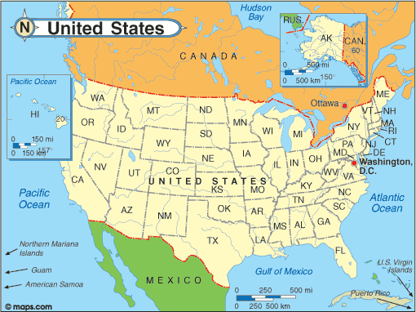
Site location for monitoring purposes
The research used the ponds, watershed and plots to do the survey
For efficiency each site was the area within the hearing distance of a point-survey location

Slide 7
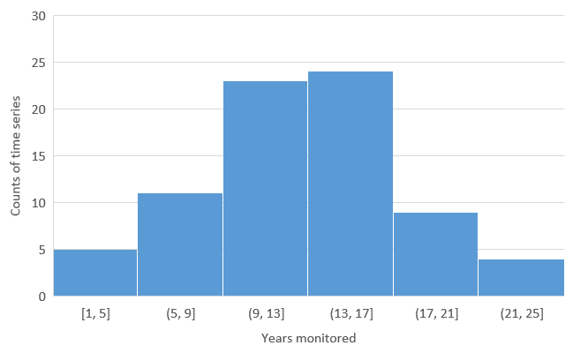
Data Analysis According to number of year monitored
Each year and mean trends in occupancy for each time series of estimates a generalized-linear mixed model was used.
Lme4 package was used in the R language of programming

Slide 8
Results
ARMI, generated 612 estimates in 2002 to 2011 of the probability of site occupancy for 108 time series.
Mean annual declined across time at the rate of -3.7%
The mean for endangered, vulnerable and near threatened categories was found to be having a mean trend of -11.6%
There was no geographical differences in relation to the rate of change in estimates
Separate model that analyzed individual species was used and data was found to be sparse for most species.

Slide 9
Discussion
To understand the rate of change in amphibian patch occupancy, unbiased data is vital.
The finding suggests that the IUCN threat status has been underestimated for some of these species
Primary hypothesis were land use change, disease, global climate change and interactions of the equivalent factors were used to explain the amphibian decline.
Climate change role in amphibian decline is difficult to evaluate for a short period of time.
Methods used suggested a decline in all subsets of data examined.

Slide 10
Conclusion
Amphibians are declining in the United State
Notably the decline are high on the land owned by federal agencies
National Park services recorded the highest decline .
Management policy advocates for the protection of the ecosystem.
The decline is more severe than it was earlier though hence the need for increased attention to protect the amphibians.

